Slide 1
Intertemporal choice and inequality
Angus Deaton and Christina Paxson
Present by : Jiaxin Quan

Slide 2
Overview
Permanent Income Hypothesis (PIH) - cross-sectional dispersion of consumption within a fixed-membership group will increase over time
Over time, consumption and income inequality within a cohort of individuals born in the same year should increase as the cohort ages.
Data from the United States, Britain, and Taiwan to examine how much the within-cohort distributions of consumption, income, and earnings disperse as cohorts age.
Considered various theoretical models, and for each model they derive the implications for the evolution of within-cohort inequality and relate the theory back to their empirical findings.

Slide 3
Data
The data are drawn from 47 annual household surveys from the three countries (US, UK, Taiwan).
Cohorts are identified by their year of birth or, equivalently, by their age in a base year.
For example, take those born in 1945 (31 years old in the first survey year (1976)) - examine the distribution of consumption, earnings, and incomes for all 31-year-olds in the 1976 survey.
This distribution is then compared with the distributions of consumption, earnings, and incomes for all 32-year-olds in 1977, those for all 33-year-olds in 1978, and so on, ending with the distribution for 45-year-olds in 1990, the last survey year.

Slide 4
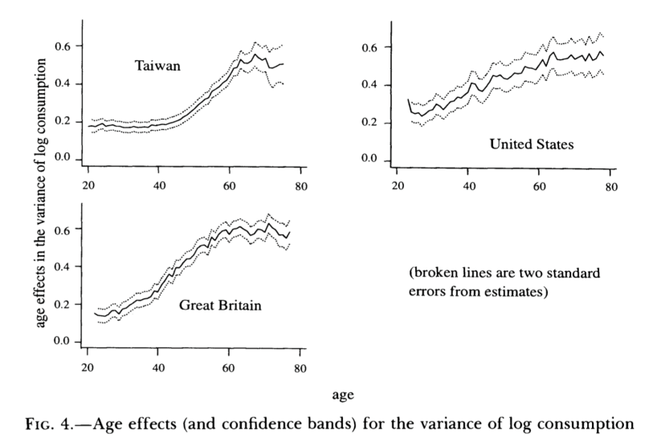
Evidences-Within-Cohort Age Profiles of Consumption Inequality

Slide 5
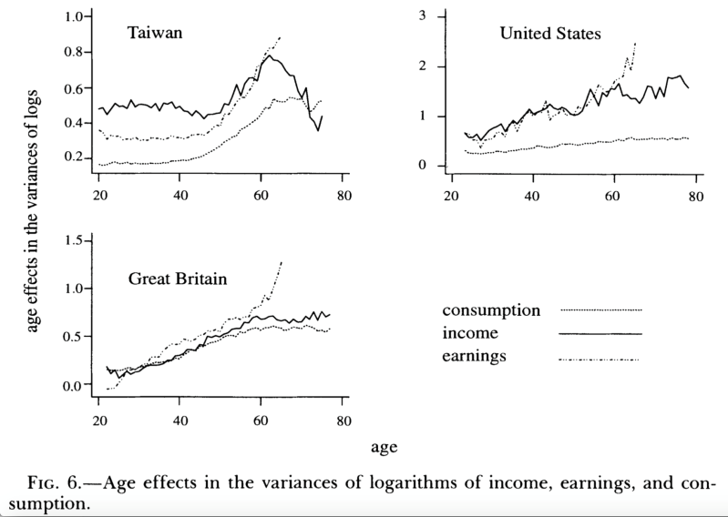
Evidences –Cohort Age Profiles of inequality in Earnings and Income

Slide 6
Theoretical Interpretations-Inequality and the Permanent Income Hypothesis
First show that the PIH implies that consumption inequality within cohorts will increase over time.
Suppose that preferences are inter temporally additive. Then optimal inter temporal choice implies the PIH, and consumption follows a martingale.
C_{it}=C_{it-1}+U_{it} (1)
Assume at any given time t, the cross-sectional covariance is zero.
Cov(C_{it-1} U_{it})=0 (2)
Using (1) and (2), take variances over any set of individuals in existence at both t- 1 and t, to give
Var_{t}(C) =Var_{t-1}(C) + σ²_{t} (3)
σ²_{t} is the period t variance of U_{it} . Equation (3) indicates that the variance of consumption increases over time.

Slide 7


Theoretical Interpretations-Inequality and the Permanent Income Hypothesis
Show that an implication of the PIH is that the dispersion of income increases with age (up to retirement).
y^{d}_{t} =(r/1+r)A_{t} +y_{t} = β_{t}c_{t} +S_{t} (4)
Define disposable income y^{d} as the sum of asset income and earnings, and saving S_{t} as the difference between disposable income and β_{t}c_{t}
Saving is the discounted present value of expected future falls in earnings
disposable income can be written in terms of earnings as
For any given stochastic process for earnings, equation above yields the corresponding process for disposable income; for a group of people with identical earnings processes, it thus controls the dispersion of disposable income over time

Slide 8
Theoretical Implications- Relaxing Certainty Equivalence
consider the implications of more general models of intertemporal choice for the dispersion of consumption.
With intertemporally additive preferences and a constant rate of time preference, the evolution of consumption is controlled by the Euler equation
Where λ(c)is the instantaneous marginal utility of consumption function and r_{t+I} is the real rate of interest from t to t + 1.
If impatience is large enough so that δ ≥ r_{t+1}, then the marginal utilities of consumption become more dispersed over time.
When the rate of interest is greater than the rate of time preference, the distribution of marginal utilities in the cross section can either concentrate or disperse, depending on the cross-sectional dispersion of the innovations.
The relationship between the dispersion of consumption and the dispersion of marginal utilities depends on the function λ.

Slide 9
Borrowing Constraints, Buffer Stock Saving, and Earnings Dispersion
Buffer Stock- An inability to borrow does not imply an inability to save, and even those who cannot borrow and have no wish to accumulate will typically have a working balance of cash on hand that acts as a reservoir for emergencies and smooth over short-term fluctuations in earnings.
Because assets buffer consumption against earnings fluctuations, consumption inequality in the cross section as well as over time will be less than earnings inequality, which, since assets are small, will be close to income inequality

Slide 10
Insurance and Consumption Inequality
There exists a complete set of state-contingent securities so that agents can insure themselves and remove idiosyncratic consumption risk.
With the model of complete insurance, it is possible that the variance of log consumption will be constant over time.

Slide 11
Conclusions and Further Implications
Based on three countries examined, within-cohort inequality does indeed increase with age, as the PIH implied.
1. Implications of the results for inequality in society as a whole. If there are no links between successive generations, if the age distribution of the population remains unchanged, and if the inequality in the distribution of earnings remains constant, consumption and income inequality will also remain constant in the society as a whole, even though inequality is increasing for each age group. The theory is therefore consistent with unchanging or slowly changing inequality in society as a whole.
2. The relationship between age and inequality forges a powerful link between demographic change and the distribution of resources, a link that is largely independent of the theoretical basis of the result.

Slide 12
Conclusions and Further Implications
3. Implications for the cross-country relationship between inequality and economic development
Inequality should rise in the early stages of economic development but should eventually fall as incomes rise, a result in terms of the urbanization that typically accompanies economic growth.
Economic development is eventually accompanied by a demographic transition, from high fertility to low fertility, a transition that eventually redistributes population from young to old.
Such a redistribution will tend to lead to widening inequality, at least until the new stable population distribution is established, at which point inequality growth will cease.
Income growth may itself affect inequality independently of these demographic effects, with higher growth rates resulting in greater inequality across cohorts.

